Slide 1
HINDUSTAN UNILEVER LIMITED
“feel good, like good & get more out of life”
DR. SRINIBASH DASH
Associate professor & Head
School of Management
SBP,GMU

Slide 2

“We meet everyday needs for nutrition, hygiene and personal care with brands that help people feel good, look good and get more out of life.”

Slide 3
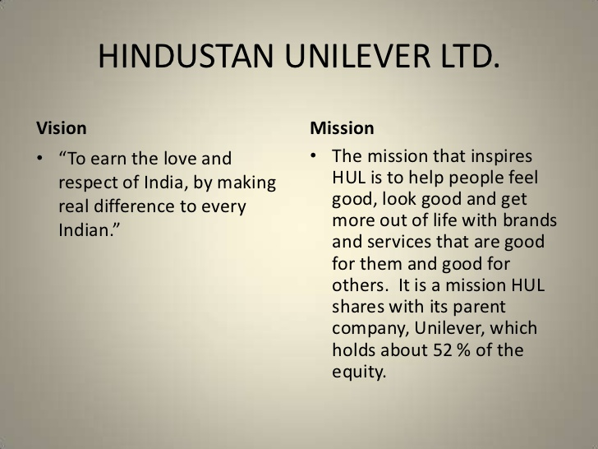

Slide 4
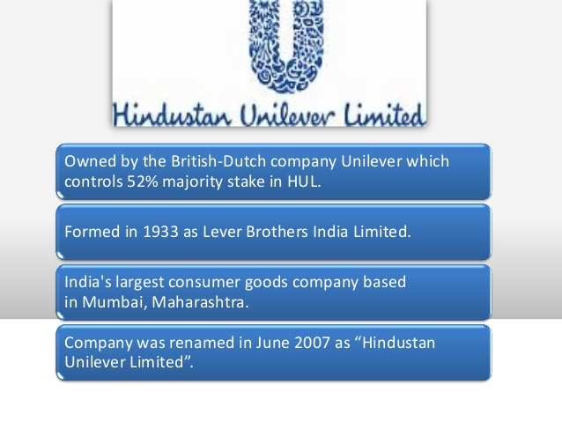

Slide 5
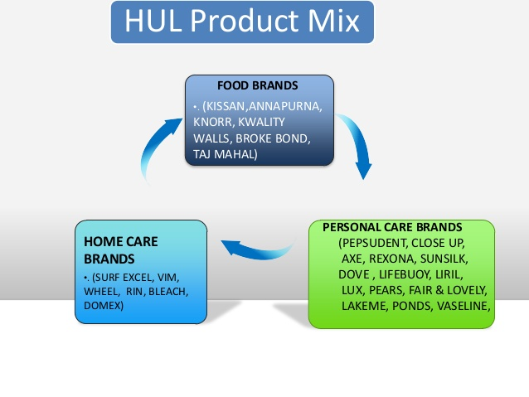

Slide 6
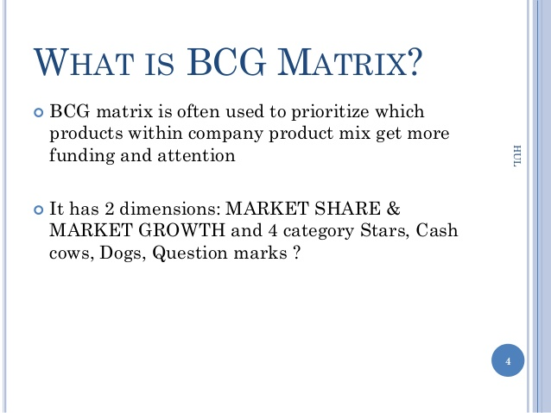
WHAT IS BCG MATRIX ?

Slide 7
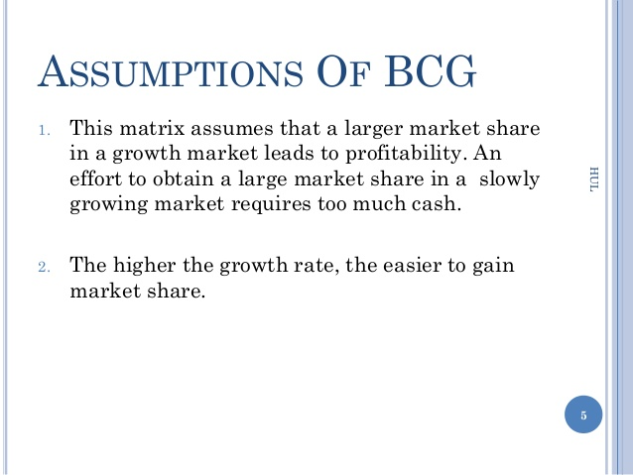

Slide 8
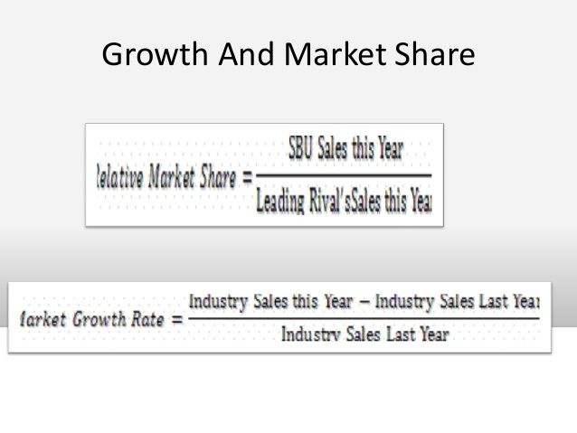

Slide 9
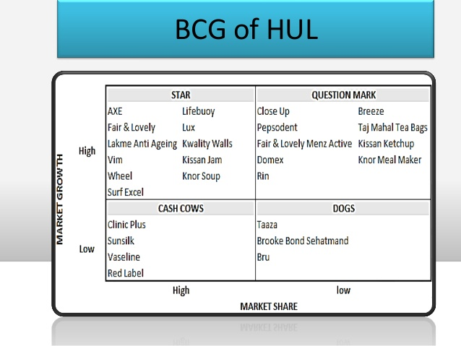

Slide 10
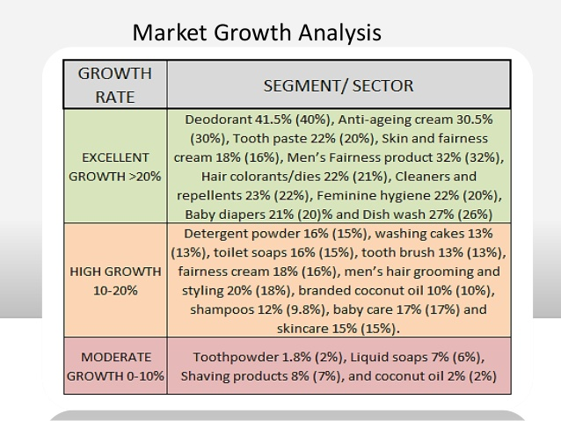

Slide 11
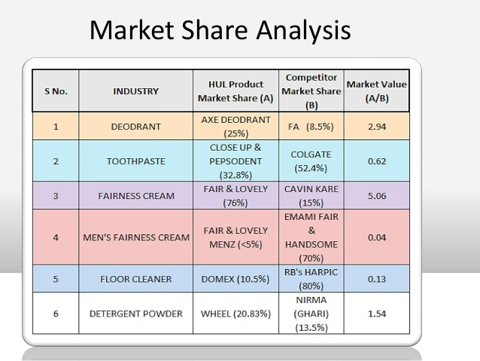

Slide 12
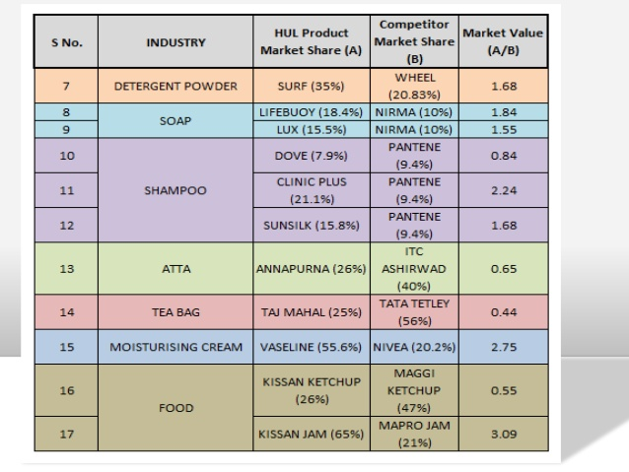

Slide 13
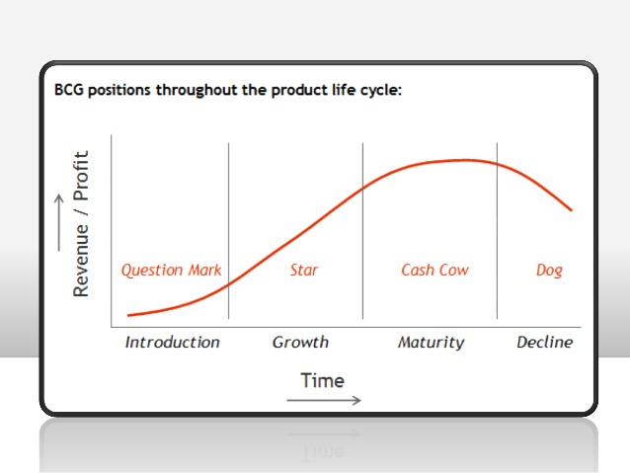

Slide 14
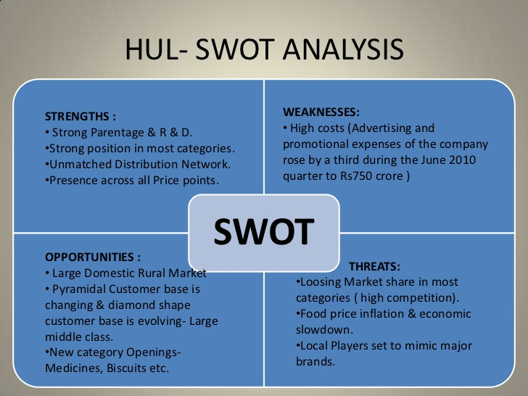

Slide 15
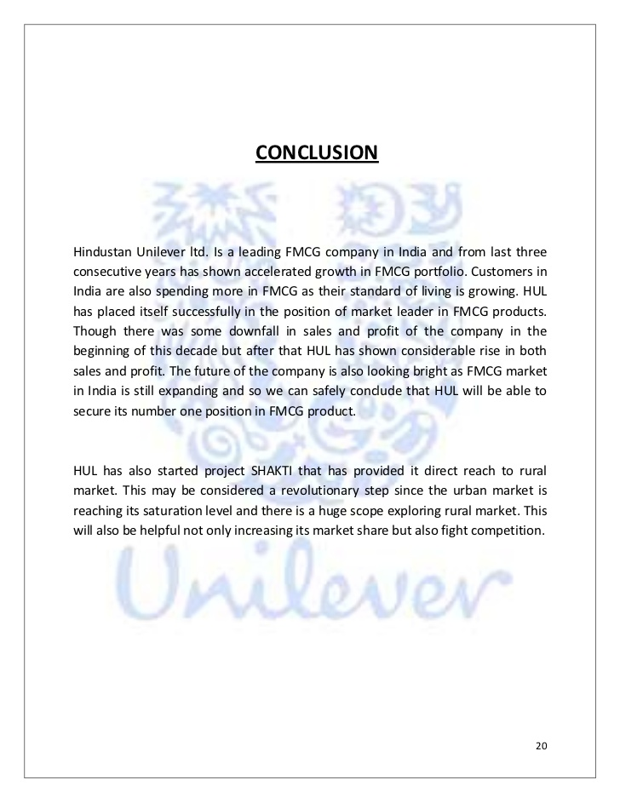

Slide 16


